Slide 1



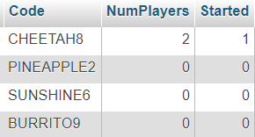
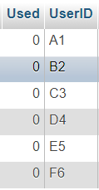
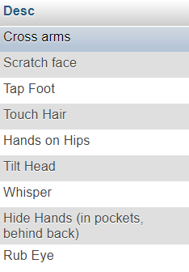
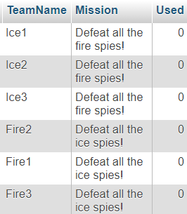
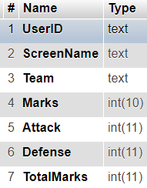
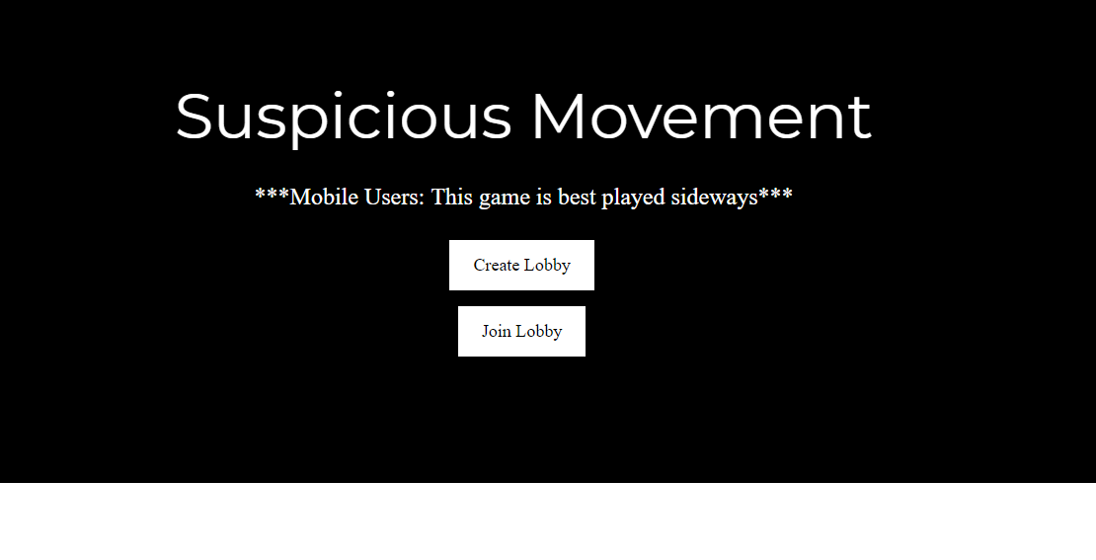
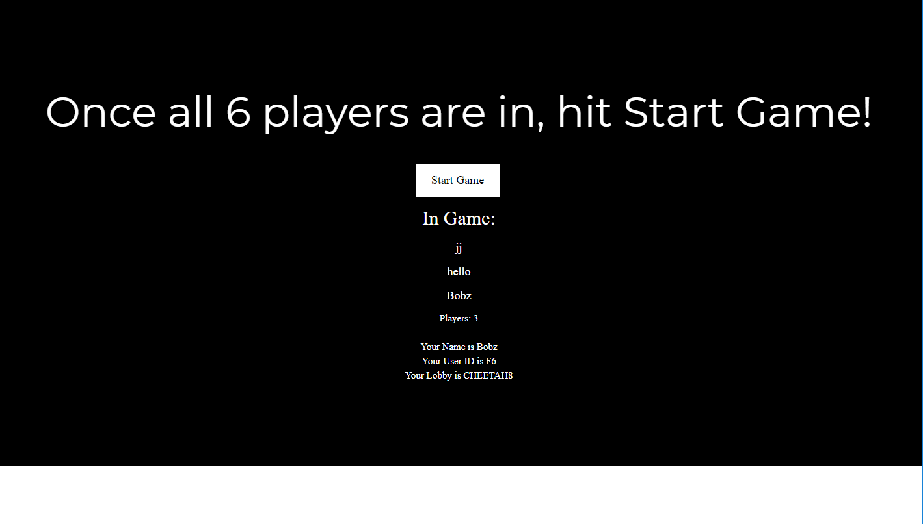
Suspicious Movement: The Game
Angela Ku, Noah Zbinden, Jelaiya Jacob, Nick Moreno, Jay Robinson
EGR302-C, Dr. Im
Department of Computing, Software, and Data Sciences
Gordon and Jill Bourns College of Engineering
California Baptist University
Synopsis and Game Description
Suspicious Movement is a spinoff on a traditional roleplaying game—the theme for this edition is spies. Players will work on different spy teams to defeat the other team in an epic, multilayered unique game experience. Collecting information, tactical movement, chasing and hiding, teamwork, and suspicion are all elements you will find while playing this game.
How Do We Win?
This game is split into 3 phases—make sure to read the instructions and play each phase to your team’s advantage!
Be the last person standing on your team! At the end of the game, the player with the most “health points” wins!
Make sure to discover who your teammates are (It will make the game easier.)
Don’t cheat—even in gaming we value honesty and good spirit!
Play safe or aggressively—you get to chose your playstyle!
Don’t reveal your team name to the wrong side.
How Do I Play?
Define specific and fair boundaries in a building or large area. Make sure there are places to hide!
Determine small predetermined clearing (such as a table, a grassy area, etc.) that players will return to in the last stage of the game.
Make sure you have exactly 6 players; each player must have a mobile device with decent internet connection
Make sure everyone has joined the lobby by a verbally communicated game code, and then hit Start. Once you hit start, you must spread out! You are not allowed to reveal your role to everyone yet until “Phase 1!”
Rules: No text or phone communication is allowed in the duration of this game.
Lobbies Table
UserID Table
“Tick” Table
Team Table
User Table
Play Now!
susmov.ga
Figure 2. Database Schema
Conclusion
Our game has encouraged the face-to-face interaction that has been lacking in our present era of technology. We took advantage of mobile devices that tend to take away from socializing to instead help build a fun, communicative environment among players. With the game being heavily based on social interaction, we hope that this will shed a positive light on how technology is capable of bringing individuals together rather than separating them.
Acknowledgments
We would like to acknowledge our professor, Dr. Im, who’s guidance was invaluable to the development and completion of this project.
Figure 1. Home and Start Game pages.

